Slide 1
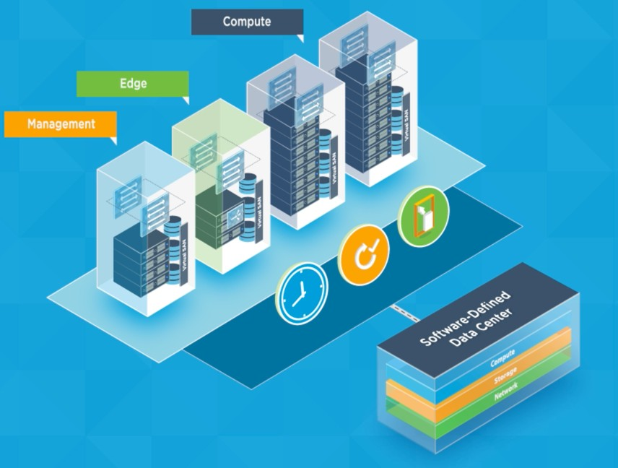
Data Center Technology
Lecture 8: Software Define Data Center (SDDC)
1

Slide 2
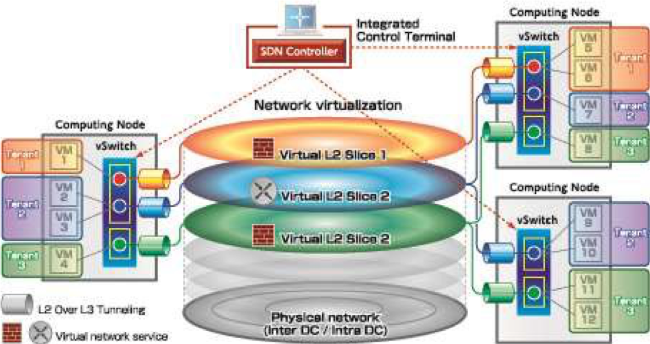
What is SDDC?
  Software-defined data center (SDDC) is the phrase used to refer to a data center where all infrastructure
is virtualized and delivered as a service.
  Control of the data center is fully automated by software, meaning hardware configuration is maintained through intelligent software systems.
  This is in contrast to traditional data centers where the infrastructure is typically defined by hardware and devices.
  they are orchestrated through a powerful platform that ensures the components work together.
2

Slide 3
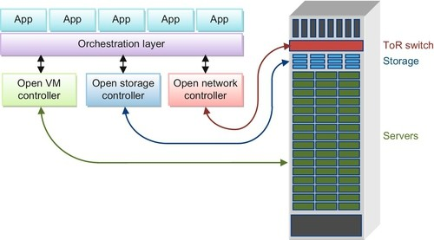
What is SDDC?
  At the top level is the orchestration layer using software such as the OpenStack cloud operating system. The orchestration layer northbound API can support multiple applications from third parties. For example, an application could monitor traffic patterns in the network and automatically adjust virtual network connections or move virtual machines in order to optimize overall network performance.
  Below the orchestration layer, there are dedicated controller software modules for servers, storage, and networking. These controllers translate commands from the orchestration layer into industry standard open APIs such as OpenStack for server virtualization and OpenFlow for networking. Controllers using open northbound and southbound APIs allow for ease of integration with orchestration layers and also allow use of standard high volume hardware from a variety of vendors that support the open API.
ToR Switch: Top of Rack Switching
3

Slide 4
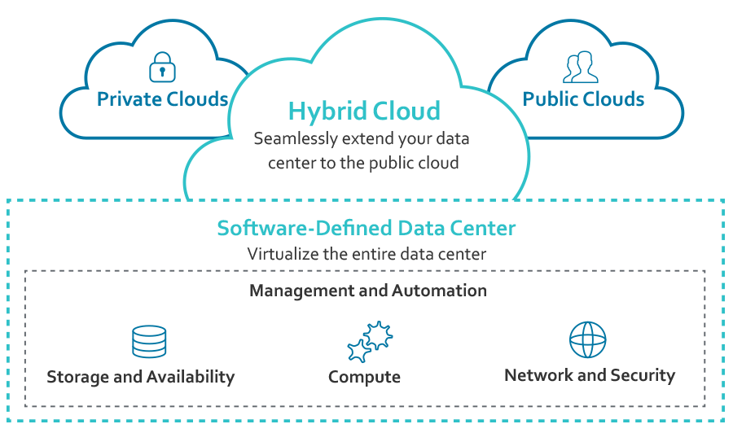
Virtualized Infrastructure
A virtual infrastructure is a software-based IT infrastructure being hosted on another physical infrastructure and meant to be distributed as a service as in cloud computing’s infrastructure as a service (IaaS) delivery model.
  Network virtualization
  Server virtualization
  Storage virtualization
  Overlay Infrastracture
4

Slide 5
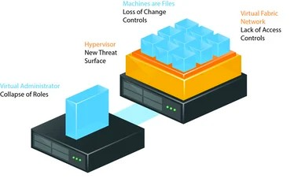
What is the virtualization
Virtualization is a technology that helps us to install different Operating Systems on a hardware. They are completely separated and independent from each other.
Virtualization hides the physical characteristics of computing resources from their users, their applications or end users. This includes making a single physical resource (such as a server, an operating system, an application or a storage device) appear to function as multiple virtual resources.
  Virtualization is often −
  The creation of many virtual resources from one physical resource.
  The creation of one virtual resource from one or more physical resource.
5

Slide 6
Types of Virtualization
Today the term virtualization is widely applied to a number of concepts, some of which are described below:
  Server Virtualization
  Client & Desktop Virtualization
  Services and Applications Virtualization
  Network Virtualization
  Storage Virtualization
6

Slide 7
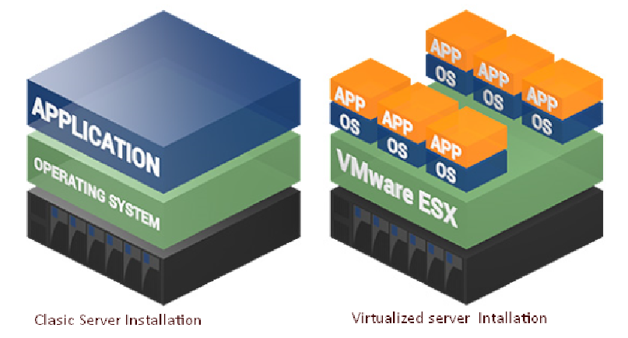
Server Virtualization
  Server virtualization is
a virtualization technique that involves partitioning a
physical server into a number of small virtual servers with the help of virtualization software.
In server virtualization.
7

Slide 8
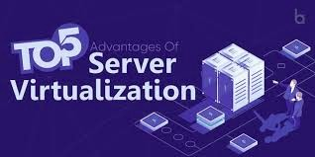
Benefits of Server Virtualization
Reduced Hardware Costs.
Faster Server Provisioning and Deployment.
Greatly Improved Disaster Recovery
Significant Energy Cost Savings
  Increased Productivity
8

Slide 9
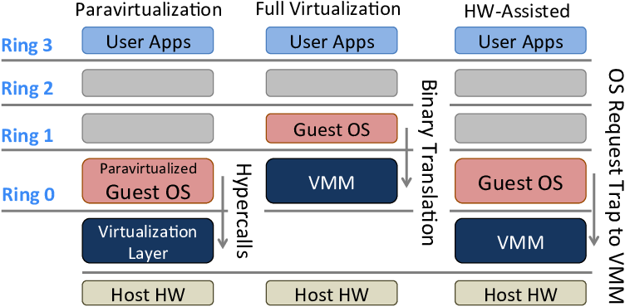
Server Virtualization Types
  There are three ways to create virtual servers:
full virtualization
para-virtualization
OS-level virtualization.
  They all share a few common traits.
The physical server is called the host. The virtual servers are called guests. The virtual servers behave like physical machines. Each system uses a different approach to allocate physical server resources to virtual server needs.
9

Slide 10
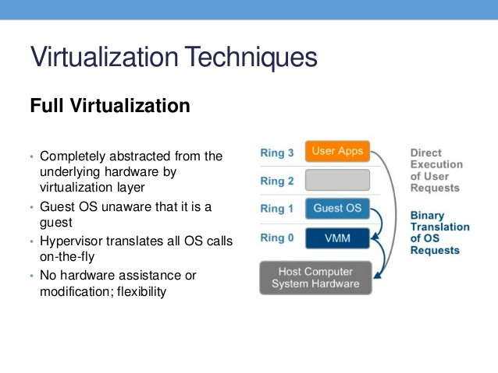
A) Full virtualization
  Full virtualization uses a special kind of software called a hypervisor. The hypervisor interacts directly with the physical server's CPU and disk space. It serves as a platform for the virtual servers' operating systems. The hypervisor keeps each virtual server completely independent and unaware of the other virtual servers running on the physical machine. Each guest server runs on its own OS -- you can even have one guest running on Linux and another on Windows.
  The hypervisor monitors the physical server's resources. As virtual servers run applications, the hypervisor relays resources from the physical machine to the appropriate virtual server.

Slide 11
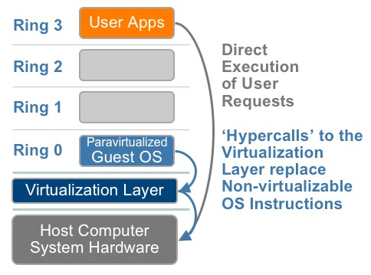
B) para-virtualization
  The para-virtualization approach is a little different. Unlike the full virtualization technique, the guest servers in a para- virtualization system are aware of one another. A para- virtualization hypervisor doesn't need as much processing power to manage the guest operating systems, because each OS is already aware of the demands the other operating systems are placing on the physical server.
The entire system works
together as a cohesive unit.

Slide 12
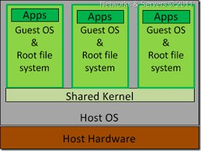
C) OS-level virtualization
  An OS-level virtualization approach doesn't use a hypervisor at all.
Instead, the virtualization capability is
part of the host OS, which performs all the functions of a fully virtualized hypervisor. The biggest limitation of this approach is that all the guest servers must run the same OS. Each virtual server remains independent from all the others, but you can't mix and match operating systems among them.

Slide 13
Understanding Different Types of Hypervisors
A hypervisor is a thin software layer that intercepts operating system calls to the hardware. It is also called as the Virtual Machine Monitor (VMM). It creates a virtual platform on the host computer, on top of which multiple guest operating systems are executed and monitored. Hypervisors are two types:
  Native of Bare Metal Hypervisor and
  Hosted Hypervisor
13

Slide 14
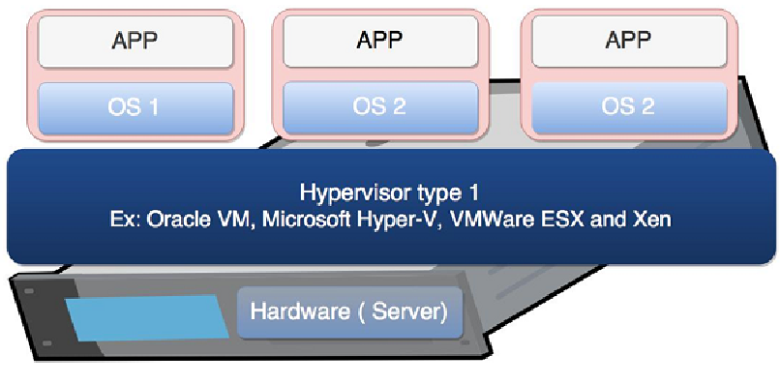
Native or Bare Metal Hypervisor
  Native hypervisors are software systems that run directly on the host's hardware to control the hardware and to monitor
the Guest Operating Systems.
The guest operating system
runs on a separate level above the hypervisor. All of them have a Virtual Machine Manager.
  Examples of this virtual machine architecture are Oracle VM, Microsoft Hyper-V, VMWare
ESX and Xen.

Slide 15
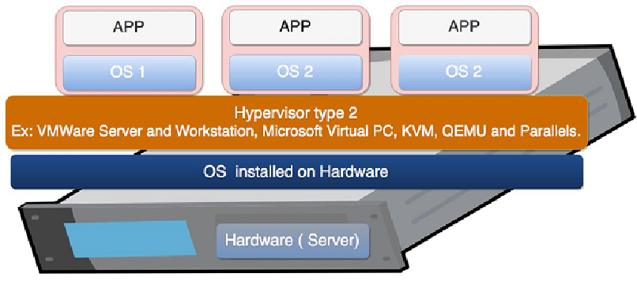
Hosted Hypervisor
  Hosted hypervisors are designed to run within a traditional operating system. In other words, a hosted hypervisor adds a distinct software layer on top of the host operating system. While, the guest operating system becomes a third software level above the hardware.
  A well-known example of a hosted hypervisor is Oracle VM VirtualBox. Others
include VMWare Server and Workstation, Microsoft Virtual PC,
KVM, QEMU and Parallels.

Slide 16
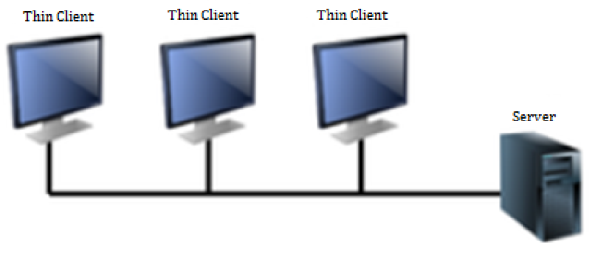
Client & Desktop Virtualization
  This is similar to server virtualization, but this time is on the user’s site where you virtualize their desktops. We change their desktops with thin clients and by utilizing the datacenter resources.

Slide 17
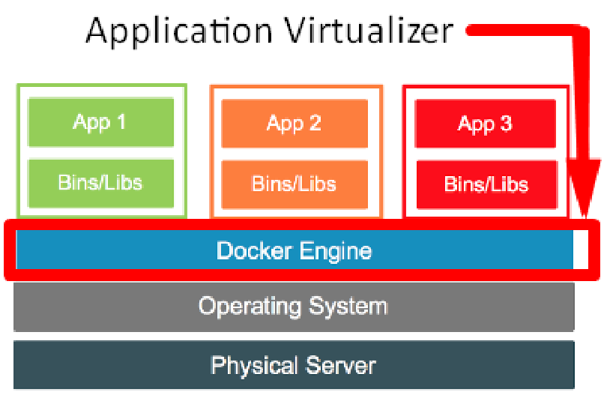
Services and Applications Virtualization
  Application virtualization (also known as process virtualization) is a software technology that encapsulates computer programs from the underlying operating system on which it is executed. A fully virtualized application is not installed in the traditional sense, although it is still executed as if it were.

Slide 18
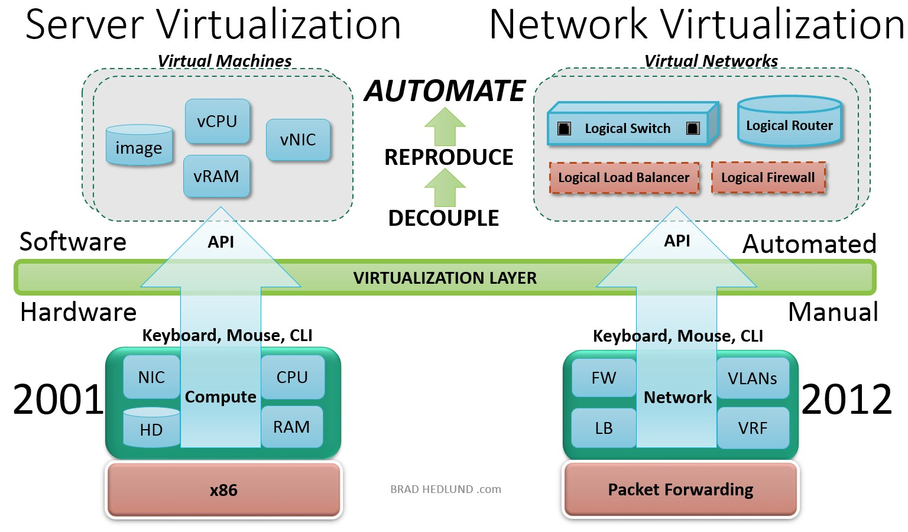
Network virtualization
Network virtualization (NV) refers to abstracting network resources traditionally delivered in hardware to software. NV can combine multiple physical networks to one virtual, software-based network, or it can divide one physical network into separate, independent virtual networks.
 NV decouples network services from the
underlying hardware and allows virtual
provisioning of an entire network.
 Physical network resources, such as switches
and routers, are pooled and accessible by any user via a centralized management system.
 NV also enables automation of many administrative tasks, decreasing manual errors and provisioning time. It can provide greater network productivity and efficiency.

Slide 19
Benefit of network virtualization
  Desirable properties of network virtualization :
  Scalability
  Easy to extend resources in need
  Administrator can dynamically create or delete virtual network connection
  Resilience
  Recover from the failures
  Virtual network will automatically redirect packets by redundant links
  Security
  Increased path isolation and user segmentation
  Virtual network should work with firewall software
  Availability
  Access network resource anytime

Slide 20
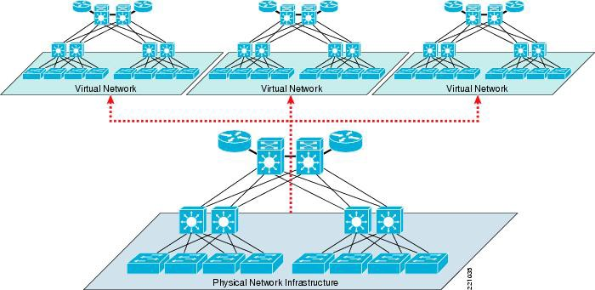
Network Virtualization Categories
  Network virtualization has Two categories :
  External network virtualization
  Combining many networks, or parts of networks, into a virtual unit.
  Internal network virtualization
  Providing network-like functionality to the software containers on a single system.

Slide 21
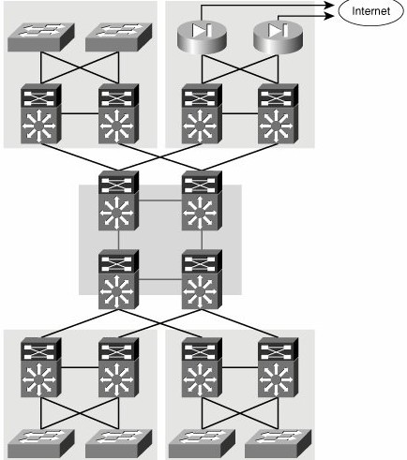
External network virtualization
  Two virtualization components:
  Device virtualization
  Virtualize physical devices in the network
  Data path virtualization
  Virtualize communication path between network access points

Slide 22
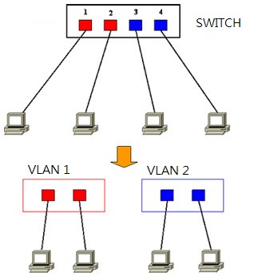
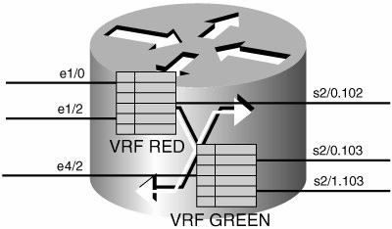
External network virtualization
  Device virtualization
  Layer 2 solution
  Divide physical switch into multiple logical switches.
  Layer 3 solution
VRF technique
( Virtual Routing and Forwarding )
  Emulate isolated routing tables within one physical router.

Slide 23
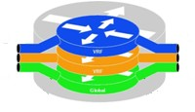

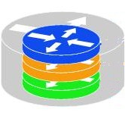
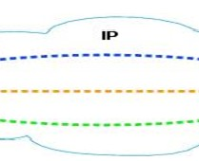
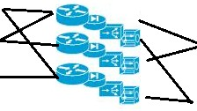
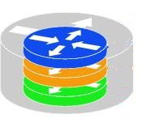
External network virtualization
  Data path virtualization
  Hop-to-hop case
  Consider the virtualization applied on a single hop data-path.
  Hop-to-cloud case
  Consider the virtualization tunnels allow multi-hop data- path.
23

Slide 24
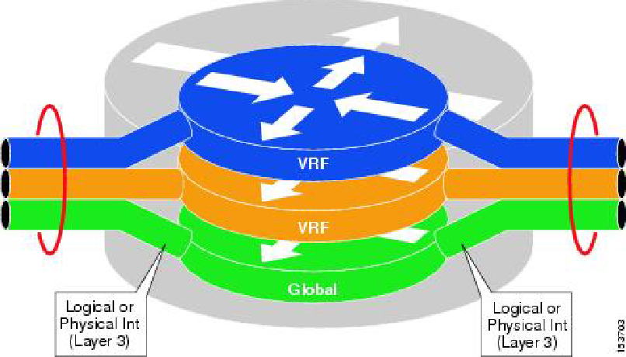
Network Device Virtualization with VRF
  A VRF instance consists of an IP routing table, a derived forwarding table, a set of interfaces that use the forwarding table, and a set of rules and routing protocols that determine what goes into the forwarding table.
  The use of VRF technology allows the customer to virtualize a network device from a Layer 3 standpoint, creating different "virtual routers" in the same physical device.
24

Slide 25
Virtualization protocols
  Protocol approach
  Protocols usually used to approach data-path virtualization.
  Three implementations
  802.1Q – implement hop to hop data-path virtualization
  MPLS ( Multiprotocol Label Switch ) – implement router and switch layer virtualization
  GRE (Generic Routing Encapsulation ) – implement virtualization among wide variety of networks with tunneling technique.
25

Slide 26
Internal Network Virtualization
  Internal network virtualization
A single system is configured with containers, such as the Xen domain, combined with hypervisor control programs or pseudo-interfaces such as the VNIC, to create a “network in a box”.
This solution improves overall efficiency of a single system by isolating applications to separate containers and/or pseudo interfaces.
  Virtual machine and virtual switch :
The VMs are connected logically to each other so that they can send data to and receive data from each other.
Each virtual network is serviced by a single virtual switch.
A virtual network can be connected to a physical network by associating one or more network adapters (uplink adapters) with the virtual switch.

Slide 27
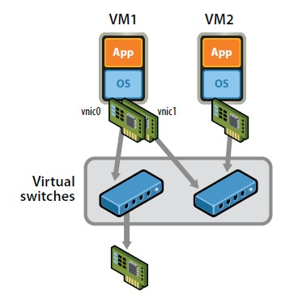
Internal Network Virtualization
  Properties of virtual switch
  A virtual switch works much like a physical Ethernet switch.
  It detects which VMs are logically connected to each of its virtual ports and uses that information to forward traffic to the correct virtual machines.
  Typical virtual network configuration
  Communication network
  Connect VMs on different hosts
  Storage network
  Connect VMs to remote storage system
  Management network
  Individual links for system administration

Slide 28
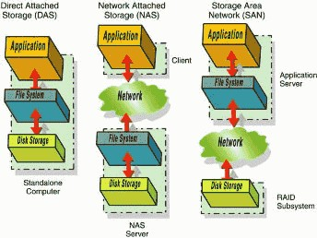
Storage Virtualization
Type of Storage:-
  Direct Attached Storage (DAS).
  Network Attached Storage (NAS).
  Storage Area Networks (SAN).

Slide 29
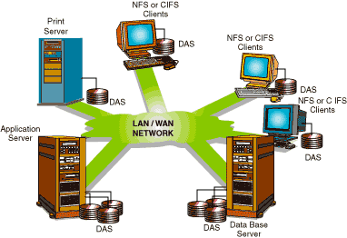
Direct Attached Storage (DAS)
  greater than 95% of all computer storage devices such as disk drives, disk arrays and RAID systems are directly attached to a client computer through various adapters with standardized software protocols such as SCSI, Fibre Channel and others. This type of storage is alternatively called captive storage, server attached storage or direct attached storage (DAS)

Slide 30
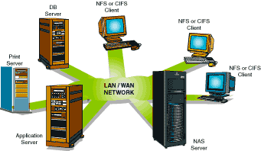
Network Attached Storage (NAS)
  There are two true network standards for accessing remote data that have been broadly implemented by virtually all UNIX and Windows NT system vendors.Developed and put into the public domain by Sun Microsystems, Network File System (NFS) is the de-facto standard for UNIX.
  Developed by IBM and Microsoft, Common Internet File System (CIFS) is the standard for all flavors of the Windows operating system.
 
As a result of these broadly accepted standards for network data access, storage devices that serve data directly over a network (called Network Attached Storage or NAS devices) are far easier to connect and manage than DAS devices. Also, NAS devices support true file sharing between NFS and CIFS computers, which together account for the vast majority of all computers sold

Slide 31
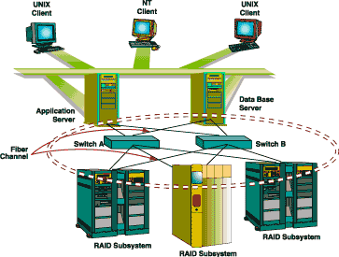
Storage Attached Network (SAN)
  Instead of putting the storage directly on the network, the emerging SAN concept puts a network in between the storage subsystems and the server
  SAN evolved from the storage industry where standards have been weak, therefore SAN implementations are not standardized.
  SAN is also appropriate for applications where the well known Fibre Channel (FC) and Fibre Channel Protocol for SCSI (FCP) security risks can be managed and where performance bottlenecks arising form Fibre Channel node and link congestion can be avoided.

Slide 32
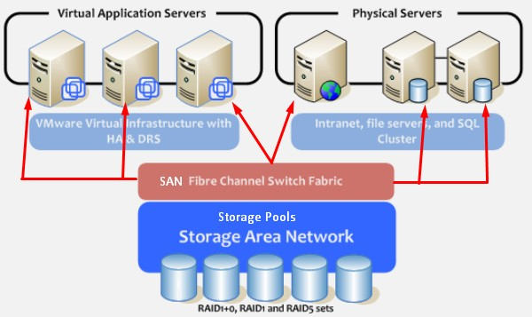
Storage Virtualization
  In simple terms, Storage virtualization is the process of representing physical storage in the logical form to any server.
  This logical storage will look like physical storage to a server or host, which means server won’t be able to differentiate between physical storage and logical storage.
  In storage virtualization, multiple physical disks are combined into a group and from that group of physical disks, virtual storage or logical storage blocks are assigned to a server for use.
  The simplest examples of storage virtualization object are LUN’s (Logical unit number), Logical volume (LV), RAID groups, etc.

Slide 33
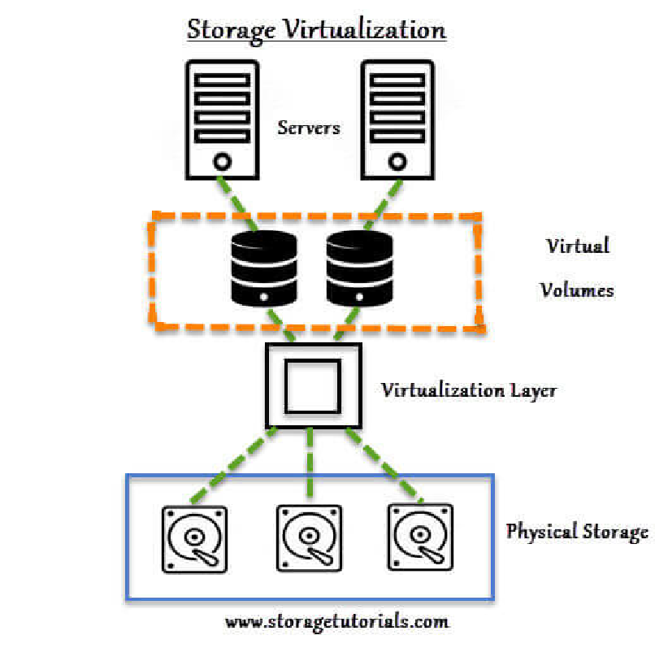
Benefits of Storage Virtualization
  It is highly scalable.
  It allows easy addition and deletion of storage without affecting any application.
  Easy data migration.
  Easy storage management.

Slide 34
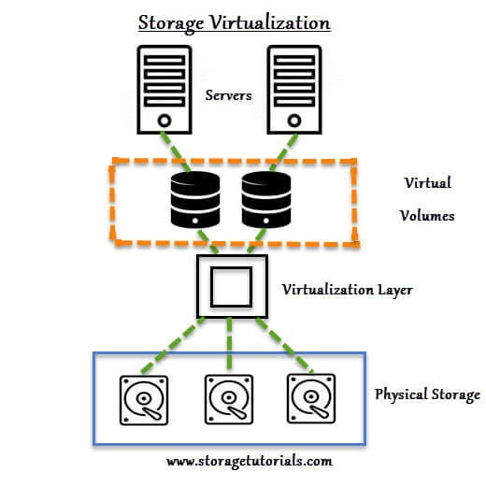
Example of Storage Virtualization
  We have made a simple to understand diagram of storage virtualization. There are 2 servers with the virtual volumes.
These virtual volumes may be mapped to different applications. Between the actual storage and the virtual volume there is virtualization layer which helps in redirecting the I/O.
  Understand that the physical storage or hard disks are combined or grouped together and then with the help of virtualization software this physical disks are divided into small blocks of data as per the requirements, which is presented to remote servers as a virtual disk. These virtual blocks of data look as the physical disk to the server.

Slide 35
Configurations of Storage Virtualization
  There are 2 ways in which storage virtualization can be implemented at the network. The first one is in- band method in which the virtualized environment configuration is stored in the data path.
  The second method is out-of-band method, in which the virtualization implementation takes place external to the data path.

Slide 36
Types of Storage Virtualization
Block level storage virtualization is implemented in “SAN (storage area network)” and it provides a translation layer in the SAN, between the hosts and the storage arrays.
In this type of storage virtualization, servers are redirected to virtualized LUNs instead of LUN’s on the individual storage array. These virtualized LUNs are on the virtualized device.
File level storage virtualization happens at NAS (network attached storage) level and help in solving NAS problems by removing the dependencies between the data accessed at the file level and the location where the files are physically stored.
With File-level virtualization files can be moved very easily and it provides user or application independence from the location where the files are stored. This type of storage virtualization form a logical pool of storage and enable users to use a logical path, rather than a physical path, to access files.

Slide 37
References
  https://www.vmware.com/topics/glossary/content
/network-virtualization
  http://bradhedlund.com/2013/05/28/what-is- network-virtualization/
  https://www.cisco.com/c/en/us/td/docs/solutions
/Enterprise/Network_Virtualization/PathIsol.html# wp43481
  https://www.tutorialspoint.com/virtualization2.0/vi rtualization2.0_overview.htm
  https://www.storagetutorials.com/what-storage- virtualization/
  http://www.storagesearch.com/auspexart.html
  https://computer.howstuffworks.com/server- virtualization2.htm
  https://blog.gigamon.com/2018/01/04/network- virtualization-optimize/

